Slide 1
ARIZONA CHARITABLE TAX CREDIT
FOR CORPORATIONS
Private Education Tax Credit
If your company pays Arizona state taxes, you can redirect all or a portion of those taxes to support BHGH scholars in their pursuit of a quality education!
EXECUTIVE DIRECTOR
AMY PFEIFER
JANUARY 2023

Slide 2
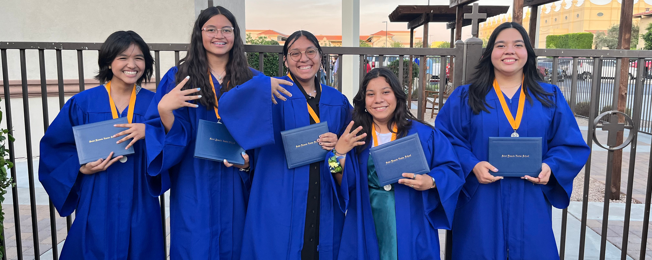
ABOUT US
The mission of Boys Hope Girls Hope (BHGH) is to nurture and guide motivated young people in need to become well-educated, career-ready men and women for others.

Slide 3
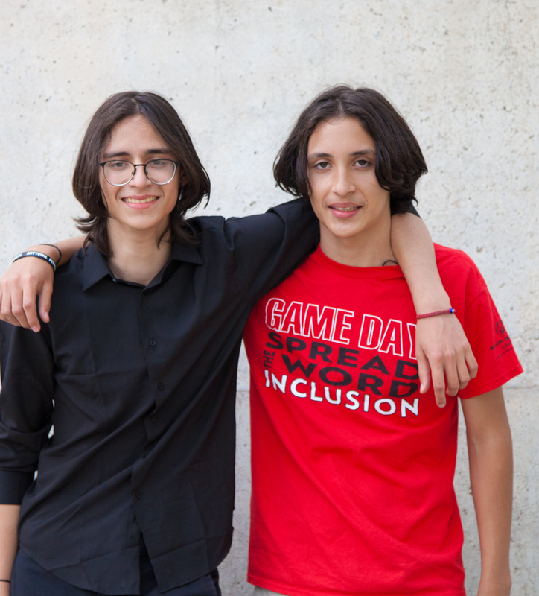
WE PROVIDE
Educational Scholarships
Academic Support and Supplies
Enrichment Opportunities
Other Resources Needed to Reach Their Full Potential.

Slide 4
WHY PRIVATE/CATHOLIC EDUCATION?
99% of students at Catholic schools graduate from high school
97% of these graduates go on to post-secondary education or enter the military
Graduates of Catholic schools are among the highest recipients of university scholarships
Alliance for Catholic Education (ACE) research indicates:
The achievement gap* is smaller in faith-based schools.
Students in Catholic and other private schools demonstrate higher academic achievement on average than students from similar backgrounds in public schools.
Latino and African American students who attend Catholic schools are more likely to graduate from high school and more likely to graduate from college than their public-school peers.
Multi-disadvantaged students benefit most from Catholic schools.
Graduates of Catholic schools are likely to earn higher wages.
Catholic schools tend to produce graduates who are more civically engaged, more tolerant of diverse views and more committed to service as adults.
*Achievement gap refers to the observed, persistent disparity of educational measures between the performance of groups of students, especially groups defined by socioeconomic status, race/ethnicity and gender.

Slide 5
AZ STATE CORPORATE TAX CREDIT
The Arizona State Corporate Income Tax Credit allows a corporation (C-Corps, S-Corps and Insurance Companies) to contribute to a qualified STO (School Tuition Organization) and receive a dollar-for-dollar tax credit up to the total amount of their tax liability.
Donation Deadline: June 30 each year (for the company’s tax filing year)

Slide 6
MORE DETAILS.....
01
Business does not have to be based in AZ; they just must have an AZ state tax liability
02
Aggregate contribution (minimum donation) is $5,000. Max donation is generally limited to an entity’s Arizona tax liability.
03
Unused credits can be carried forward for five years. Check with your tax pro!
04
Corporate Deadline: June 30

Slide 7
HOW TO DONATE
Complete a simple form with one of the following School Tuition Organizations (STO) by June 30th. Choose from our STO Partners below:
BROPHY COMMUNITY FOUNDATION – brophyprep.org
Dawn Kennedy– dkennedy@brophyprep.org
(602) 264-5291 x6500
CATHOLIC EDUCATION ARIZONA - catholiceducationarizona.org
Deb Preach - dpreach@cea.org
(602) 218-6542
ARIZONA EDUCATION SCHOLARSHIP FUND - apesg.org
Richard Doe - richard@apesf.org
(480) 264-3290

Slide 8
QUESTIONS? ASK A PROFESSIONAL
Please reach out to either of these professionals who have participated in the Corporate Private Education Tax Credit:
APS/PINACCLE WEST CAPITAL CORP
Steve Barela - DIR. INDIRECT TAXES & TAX POLICY - steve.barela@aps.com
(602) 250-2942
CAMELOT HOMES
Paul Engler - CFO - paul@camelothomes.com
(480) 367-4300

Slide 9
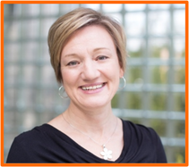
DISCLAIMER:
Boys Hope Girls Hope is not a tax advisor. To learn more, visit the Arizona Department of Revenue and see Charitable Tax Credits for corporations. Please consult your tax professional.
Boys Hope Girls Hope of Arizona | bhghaz.org | infoaz@bhgh.org
To learn more about Boys Hope Girls Hope and how you can support our scholars, please contact Amy Pfeifer.
AMY PFEIFER
EXECUTIVE DIRECTOR
AFPEIFER@BHGH.ORG
(602) 266-4873
THANK YOU!

